Slide 2
Stock Price Prediction using Time Series Analysis and Sentimental Analysis
Submitted to:
Prof.Anurag Punde
Department of Computer Science and Engineering

Slide 3
Supervised by: Prof. Praveen Bhanodia
Team Members
1.Suyash Jain
2.Yagvendra Khichi
3.Yashwant Patidar
4.Yogesh Sharma

Slide 4
Project Presentation Outline
Abstract
Introduction
Problem Statement
Survey of Existing Systems
Project Objectives
Requirement Analysis
Solution Proposed
Models and Diagrams
The Implementation
Testing
The Outcome Discussion
Conclusions and Limitations

Slide 5
Abstract
Forecasting stock prices is a significant issue in business and academic research.
Because of the immediate financial rewards, stock price prediction has always piqued the curiosity of those interested in participating in the stock market and stock exchanges.
The prediction of stock market returns is a very difficult topic that is dependent on a variety of factors.

Slide 6
Introduction
“Stonks” is a stock price prediction software that provides sentimental analysis as well.
The prediction of stock price happens after the intake of company data taken into account, and according to the analysis of company's performance on various parameters and time.
The whole idea of prediction of stock prices is to find stocks, so the return on the large investment and minimize risk.

Slide 7
The Problem Statement
Many people want to invest in the stock market, but they don't know enough about it.
New investors do not conduct proper research before choosing a company to invest in.
There are very few programs that help people identify potential investment opportunities that yield better returns.

Slide 8
Survey of Existing Systems
S. No | APPROACH USED | TRAINING TIME | ACCURACY | CLASSIFICATION (BASED ON COMPANIES)
1 | ARIMA | Very Less | 85.2 | NA
2 | SVR-RBF | Less | 96 | NA
3 | LSTM | More | 96.2 | Closing Price Could be predicted

Slide 9
Objectives
The aims of the project are as follows:
To predict the future stock price.
Generating mode, the past few years, a larger data set, used to predict the stock price.
The recent emotions towards our company from Twitter and their sentimental analysis
The project could be useful for investors to consider when investing in the stock market; based on various factors. The project's objective is to create a web application that can analyze past year's data from companies, and use that information to improve the accuracy of a model that predicts stock value over the next few days.
The main purpose of the project is to generate a predicted price for stocks and to get an idea of future values based on past data.
User can select from option to get prediction from past data or sentimental analysis or both.

Slide 10
Requirement Analysis
Functional Requirement:
Functional Requirements of the applications are as follows:
User can choose Company for which he wants to predict from list of companies.
CSV file containing previous year data of the stock price of the chosen company will be selected .
User has to press predict button to initialize the prediction process.
User can predict the future price of the stock using previous year data.
Graph will be displayed which gives an analysis of the uploaded data.
Predicted value of the stock will be given with the graph.

Slide 11
Requirement Analysis
Sentimental analysis graph will be displayed with positive and negative bars.
Application has two window:
First window contain:
This will be side tab contains a dropdown menu consisting of list of companies' names..
Predict Button to train and predict the stock price.
Second window contain:
Output graph that displays the analysis of previous year data.
Predicted value of the stock.
Sentimental analysis graph.

Slide 12
Requirement Analysis
Non-Functional Requirement
Quality attributes that can serve as requirements are described below:
PERFORMANCE
The application has better speed, faster retrieval of information with low cost.
RELIABILITY
The application will be very reliable as it will not interfere in the execution of other applications that are running simultaneously on the same system.
AVAILABILITY
The application will be freely available on the internet.
SECURITY
The application is full secured as it has login facility.
MAINTENANCE
The application is easy to maintain and regular updates will be provided.

Slide 13
Solution Proposed
The company uses the previous year's data to train the LSTM model to predict the price of shares.
Considering more parameters for prediction will result in less errors.
With more data from previous years for training the models result in a better accuracy.
The model can predict the opening and closing price by analyzing the previous close and opening, respectively.
The model can analyze the sentiments from twitter data.

Slide 14
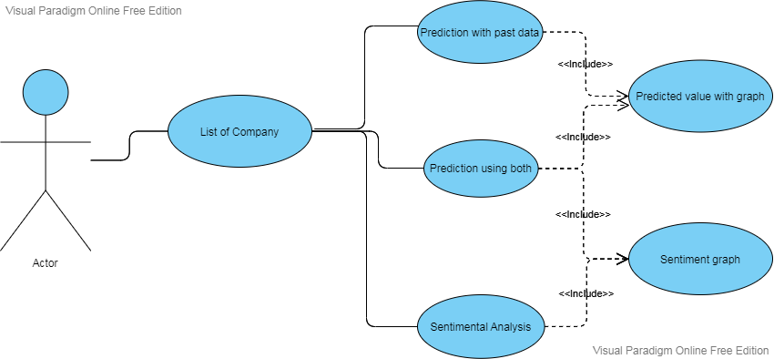
Models/Diagrams
UML Diagram

Slide 15
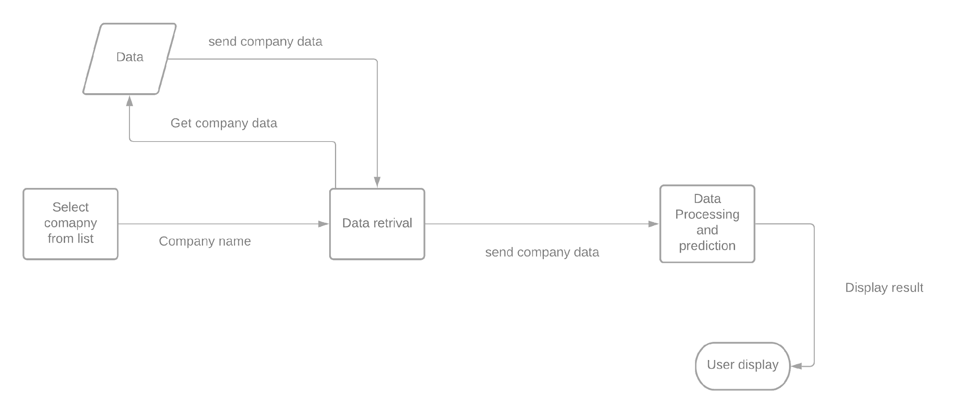
Dataflow Diagram

Slide 16
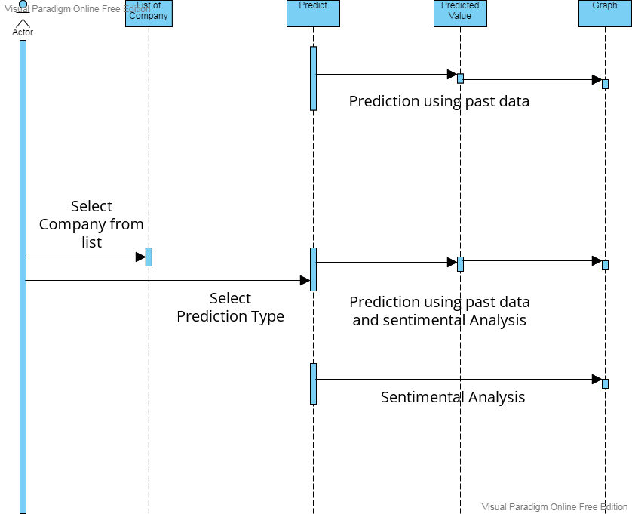
Sequence Diagram

Slide 17
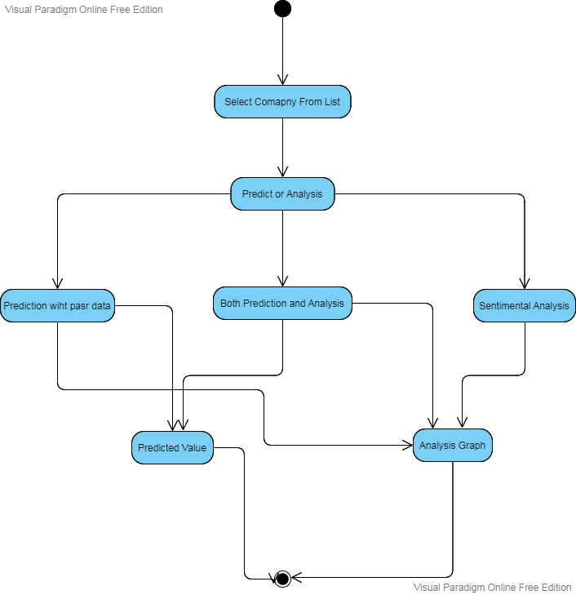
Activity Diagram

Slide 18
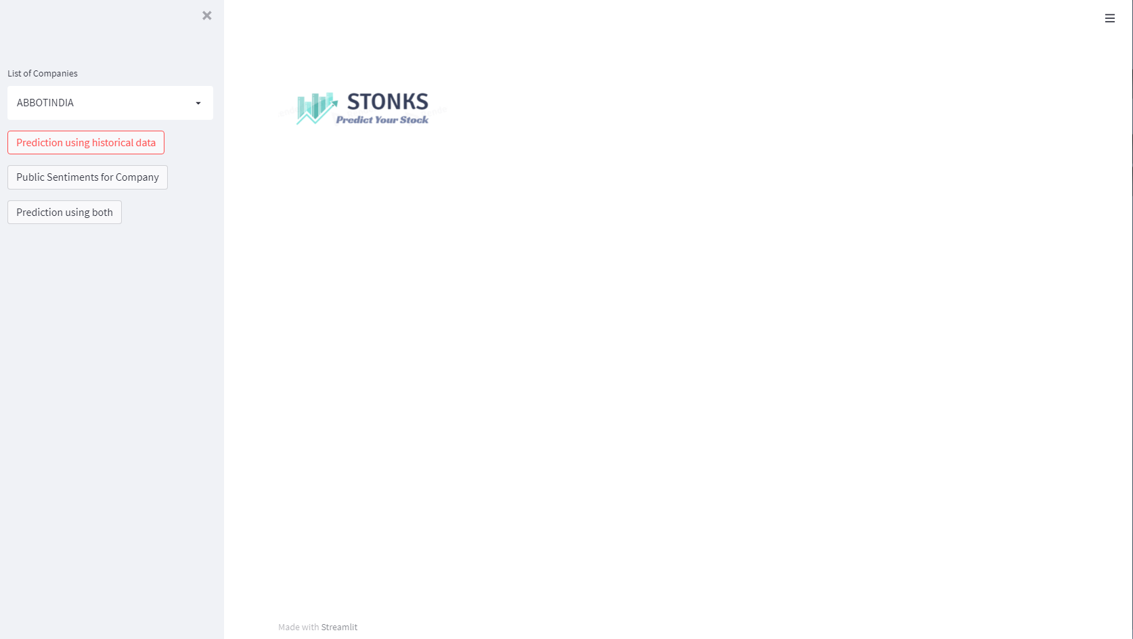
Implementations

Slide 19
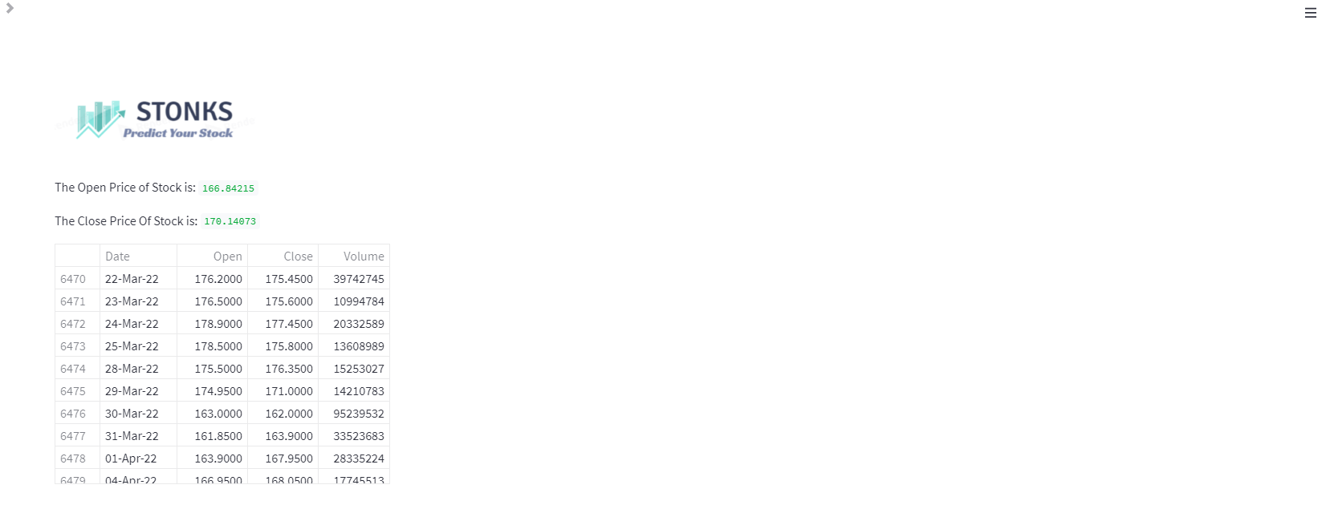

Slide 20
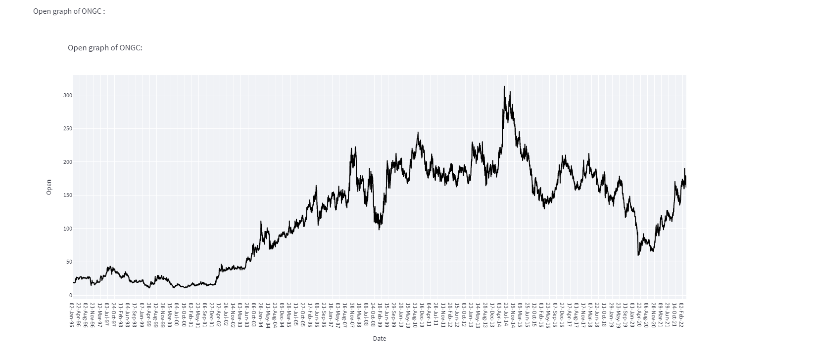

Slide 21
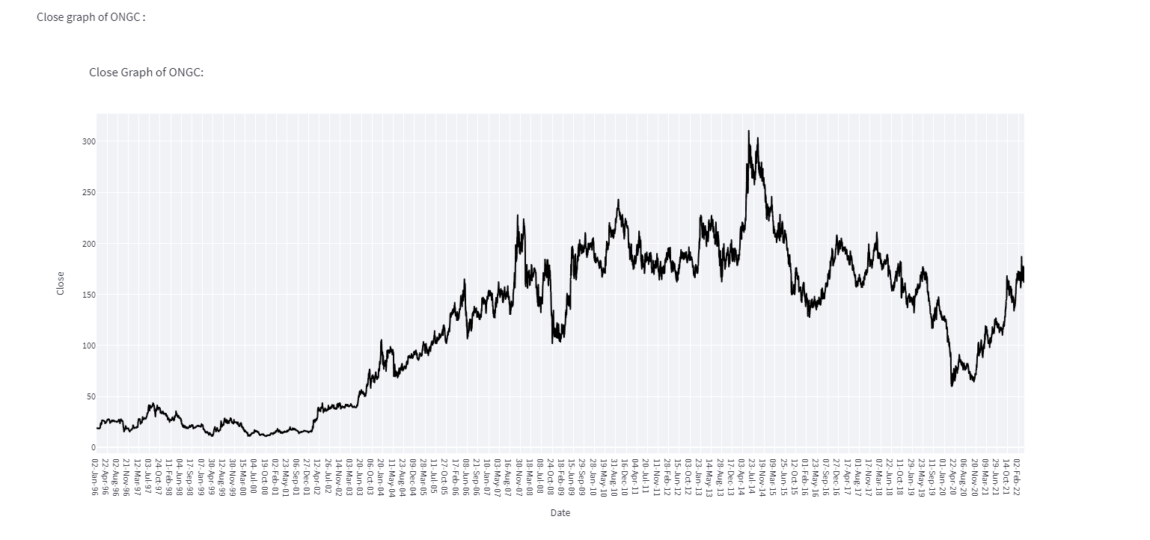

Slide 22
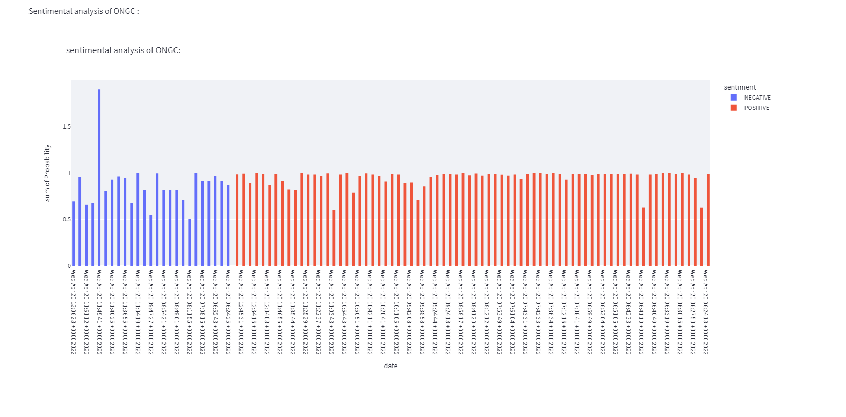

Slide 23
Testing
Testing is a process of evaluating a system to determine whether it behaves as expected and to identify any deficiencies. The testing process assesses the quality of the product. It is a process that takes place through the development process.
Tests can be conducted based on two approaches –
Functionality testing
Implementation testing
Texting the method used here is the black box test. The functionality of the program is tested. It is also called 'behavioral test. Test in this case, contains a set of input values and all the desired results. On the input provision, if the output matches with the desired results, the program is tested "OK", otherwise problematic.

Slide 24
The Outcome Discussion
User will get recent public sentiments on company.
User can analyze company stock price trends over the period.
User can get the Open and Close price of next day by using today data.

Slide 25
Conclusion and Limitation
The limitations of the project are below:
The training of data is slow.
Software excludes the minor factors (unpredictable events) that may impact the outcome.
The application cannot predict on real-time.

Slide 26
Q&A

Slide 27
THANKS

